Slide 1



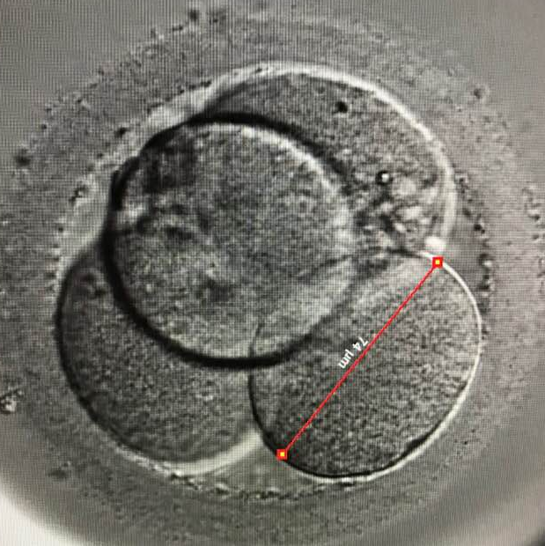
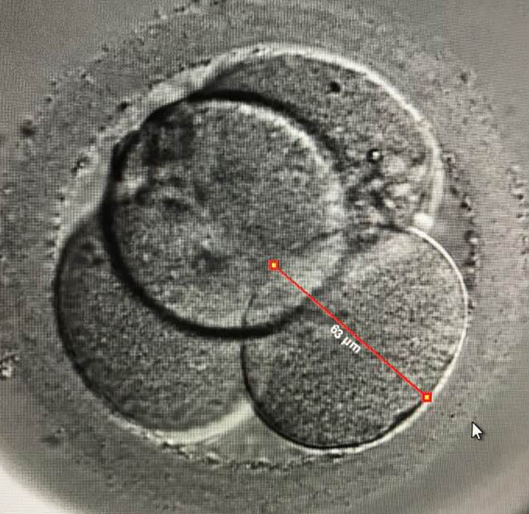
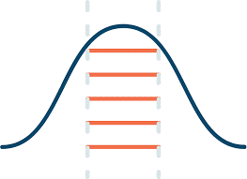

Is the Blastomere Symmetry at the 4-cell Stage Related to Ploidy? – A Pilot Study.
Tain D, Ng BL, Lim M, Chen JJ, Sinthamoney E, Wong PS
Sunfert International, Unit 2-2 Level 2, Nexus, Bangsar South, No. 7, Jalan Kerinchi,
59200 Kuala Lumpur, Malaysia
1
INTRODUCTION
OBJECTIVE
2
Unequally sized blastomeres are associated with an increased degree of aneuploidy and multinuclear rate (Vergouw et al, 2013)
The exact molecular mechanisms, interaction between polarity, cell to cell communication and cytoskeletons functioning together to enable cellular cleavage to occur are inconclusive (Adjuk and Zernicka-Goetz, 2016).
Time lapse (TL) plays an advantageous and crucial role in the determination of precise recorded time-points within controlled uninterrupted environment from fertilization to blastocyst formation.
The objective of this study is to evaluate the relationship between blastomere symmetry at the 4-cell stage with ploidy status.
3
METHODOLOGY
A total of 202 blastocysts which underwent both TL and Pre-implantation Genetic Screening in 2017 were retrospectively analyzed.
A
Time-lapse system
From the point of fertilization to the 4 cell stage, any grossly abnormal cleavage patterns (direct cleavage from 2 cell to 5 cells or reverse cleavage) or embryos with poorly demarcated cell outlines are excluded from this study.
B
Using the Embryoscope® (Vitrolife), the symmetricity of each embryo was graded at first sign of a clear 4-cell division on Day 2. The diameter of each blastomere was manually measured by tabulating the mean of 2 lines drawn perpendicularly to each other.
A diameter difference of < 25% was considered symmetrical (n=163) and ≥25%, asymmetrical (n=39).
Figure 1: A symmetrically arranged 4 cell tetrahedron embryo (left). An unsymmetrical 4 cell embryo with a large blastomere, B and a significantly smaller blastomere, A (right).
Next-Generation Sequencing
Following extended culture to blastocyst stage, trophectoderm biopsy at either Day 5 or 6 was performed followed by chromosomal evaluation using Next Generation Sequencing (VeriSeq Protocol, Illumina).
Statistical Analysis
P<0.05
The relationship between embryo symmetry and the ploidy status (euploid, mosaic and aneuploid) of blastocysts was analyzed using Chi square test.
Figure 2: Blastomere diameter measuring at 74µm (left) and 63µm (right). The blastomere has an average diameter of 68.5µm
4
RESULTS AND DISCUSSION
CONCLUSION
5
By comparing symmetry and asymmetry of embryos on the euploid, mosaic and aneuploid rate using chi-square test, there was no significant difference between the 2 groups (p=0.15).
In this study cohort, there is a trend towards higher euploid and mosaic rates in embryos with symmetrical blastomeres. Conversely there is a higher aneuploid rate with asymmetrical blastomeres with percentage difference of 15.1%. However, this is not statistically significant possibly due to the small sample size. The assessment of symmetry of blastomeres at the 4-cell stage embryo using TL can potentially be an indicator of ploidy and mosacism.
163 Symmetrical
71 Euploid
33 Mosaic
59 Aneuploid
Ploidy Rate (%)
39 Asymmetrical
15 Euploid
4 Mosaic
20 Aneuploid
6
REFERENCES
Vergouw, C. G., Al Nofal, M., Kostelijk, E. H., Rooth, H., Hompes, P. G. A., Schats, R., Lambalk, C. B. (2013). J Assist Reprod Genet, 30, 587-592
Ajduk, A., & Zernicka-Goetz, M. (2016). Molecular Human Reproduction, 22(10), 691-703
Graph 1: Comparison of the rate of Euploid, Mosaic and Aneuploid Blastocyst to the Symmetry of Day 2 4-cell embryos
CONTACT US E: info@sunfert.com P: +603 2242 3211 Fb: www.facebook.com/sunfert W: www.sunfert.com

